Slide 1
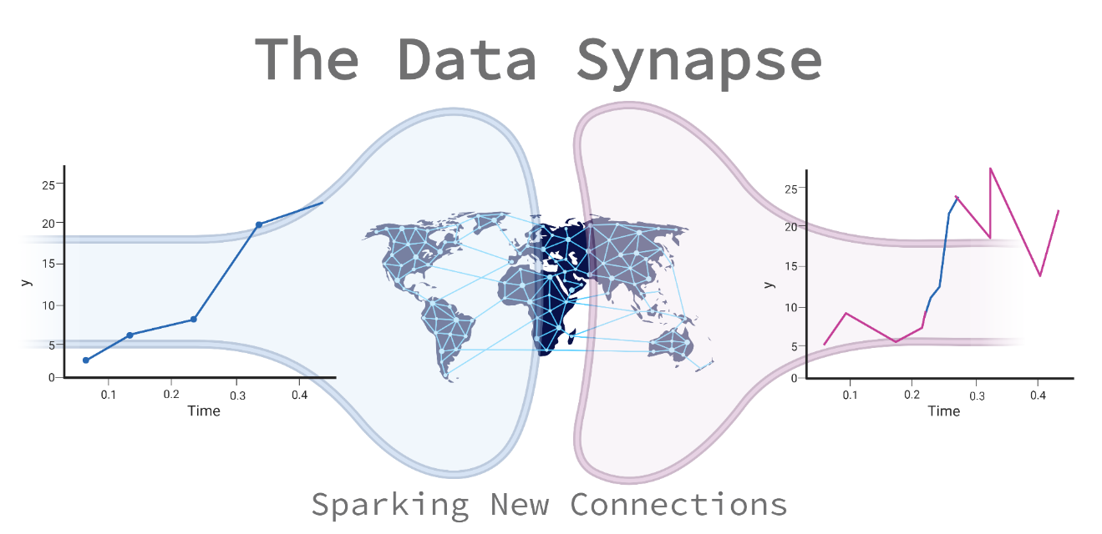
Time series search and link engine
The York Vectors
Welcome Data Science Ideathon, London 2023
Notes:
Notes on the slides (from the task book)
• The first half presenting your prototype and discussing how it addresses
the “Challenge” heading of your chosen challenge.
• The second half presenting slides that answer each of the questions
under the “Questions to answer in your presentation” heading of your
chosen challenge.
We do not expect all participants to present however we do expect you
to address how all members contributed to your solution.
Presentation accessibility: When choosing your slide template, please consider your choice of font, and the size, colour and contrasts used in both the text and in any figures, ensuring that all text and figures will be clearly readable to all members. We recommend using a widescreen aspect ratio (16:9). We do not allow movies/animations and/or transitions and they should not be included.
We will display the content from one laptop using the submitted slides.

Slide 2
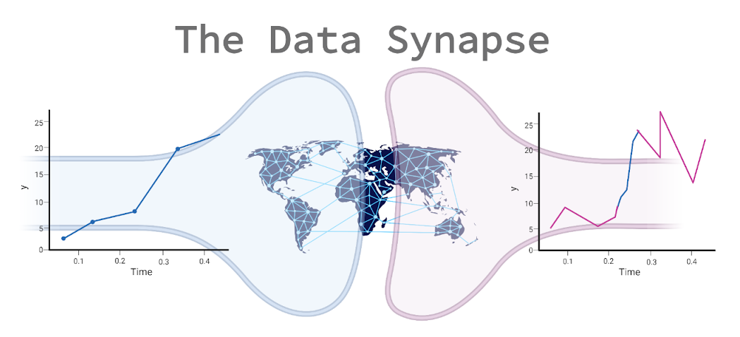
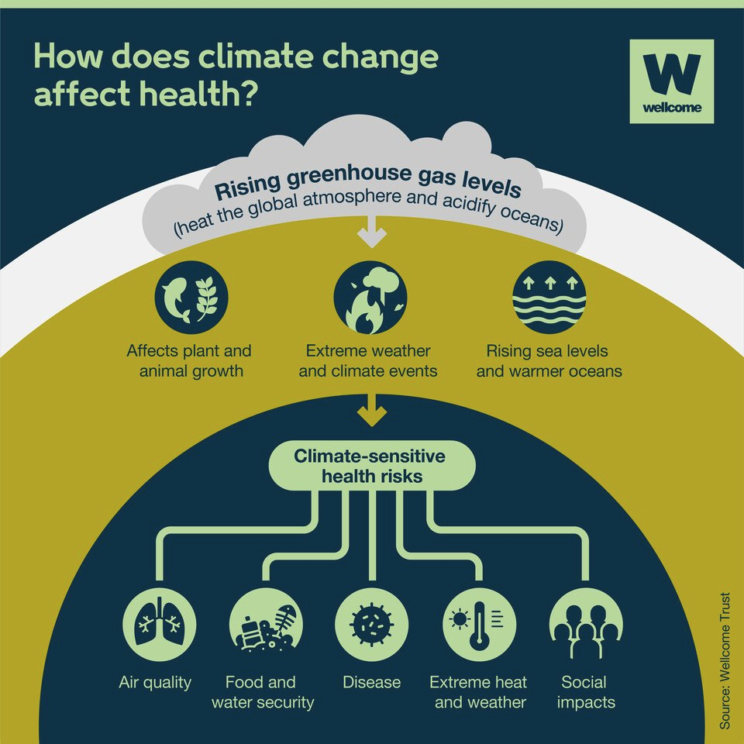
The Ideathon Challenge
Climate change is a driver of global health problems via multiple pathways such as: resource limitations; enforced migration; natural disasters.
Currently, and in the near future, this will cause significant health impacts, such as infectious disease and mental health.
One key way to help mitigate and prevent these impacts requires improving understanding of how the climate and economy interact - establishing these links will enable the development of measures to address health challenges.

Slide 3
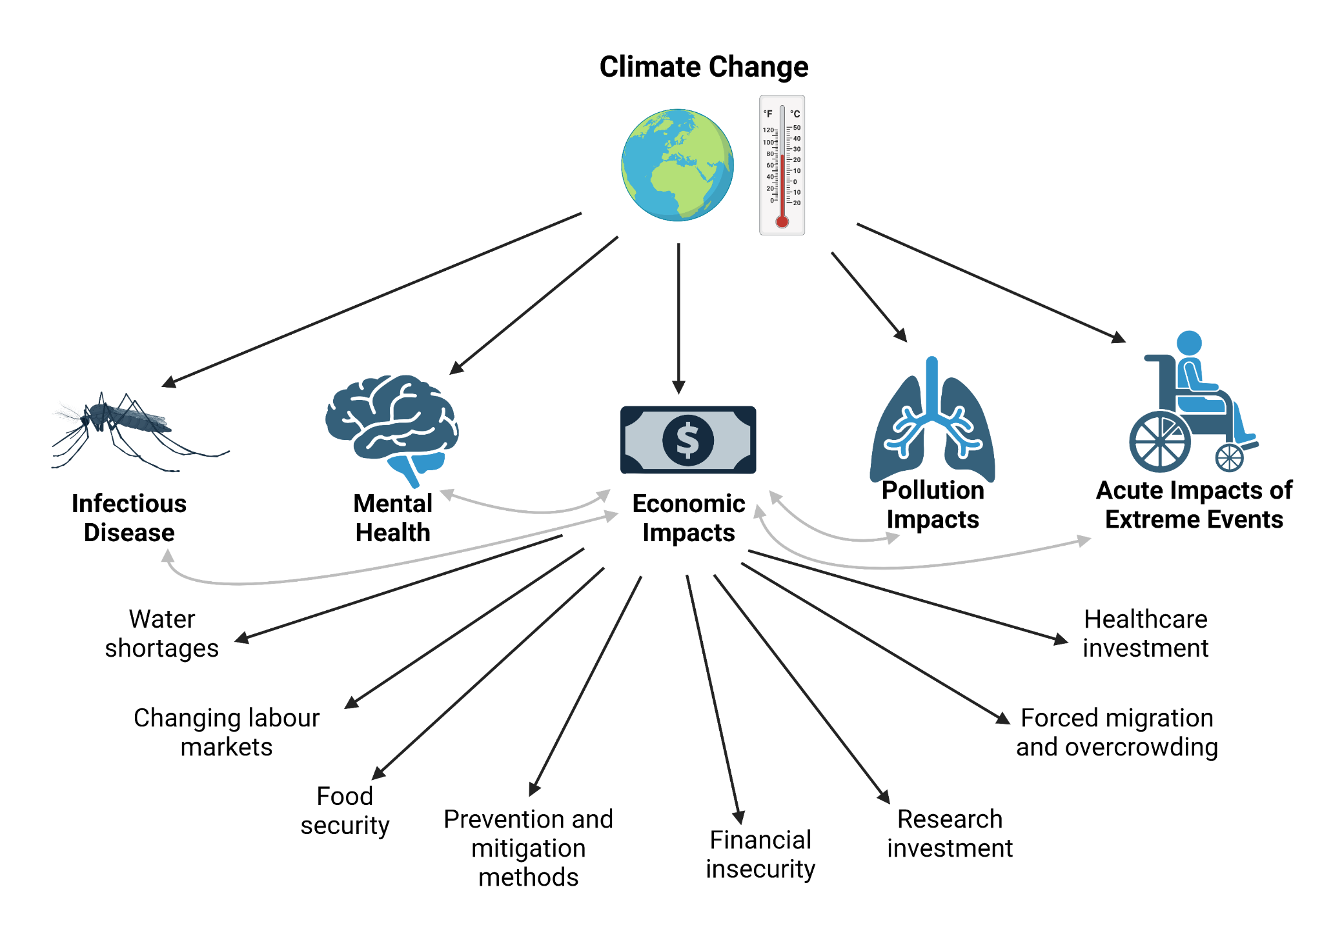
Linking Climate, Economy and Health
Created in Biorender
Notes:
Should spend 1-2 min here max
Just a couple of sentences needed - the interplay between climate, economy and health is a complex network of possible causes and effects, with multiple feedback loops between direct health impacts and indirect economic impacts. This means it is difficult to parse out cause and effect relationships between different factors.

Slide 4
The Challenge of Climate Change Data
Highly complex and heterogeneous systems
Difficult to establish causal links and magnitude of diffuse effects
Feedback loops increase complexity of interactions
Uncertainties associated with all variables, parameters and models applied
Coupled mechanistic complexity of climate change along with social effects and human activity

Slide 5
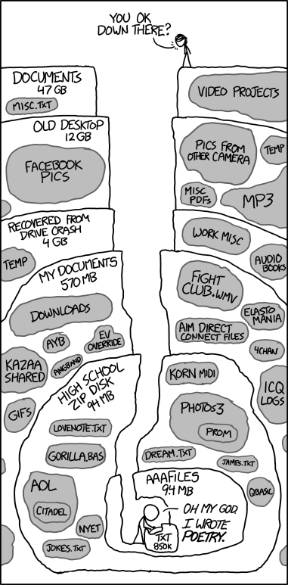
Key Problems in Establishing Links
The Data:
Available data is spread across different platforms and repositories
Incomplete and poor quality data
The Researchers:
Challenges in identifying useful sources
Accessibility of useful datasets
The Integration:
Variability in available data formats between and within fields
Temporal, spatial and other key heterogeneities make comparisons between datasets and identification of correlations difficult
xkcd : 1360: Old Files
Notes:
I wrote “the gap - the usual….” on purpose as it applies across many of these challenges
Should spend 1-2 minutes here max
Sorry Ciara, removed the following, as I think it falls outside of focus (i think we should just focus on the availability, spread, format and quality of the data). I think data access is a whole different issue, dont you think? :
Many researchers are niche experts - assistance is needed to identify key impacts, links and correlations with data from other fields
Lack of data science and coding expertise across different fields makes this even harder to standardise
Accessibility of data makes it hard to compare

Slide 6
The Proposal
Time series search and link engine
Notes:
Notes on the slides (from the task book)
• The first half presenting your prototype and discussing how it addresses
the “Challenge” heading of your chosen challenge.
• The second half presenting slides that answer each of the questions
under the “Questions to answer in your presentation” heading of your
chosen challenge.
We do not expect all participants to present however we do expect you
to address how all members contributed to your solution.
Presentation accessibility: When choosing your slide template, please consider your choice of font, and the size, colour and contrasts used in both the text and in any figures, ensuring that all text and figures will be clearly readable to all members. We recommend using a widescreen aspect ratio (16:9). We do not allow movies/animations and/or transitions and they should not be included.
We will display the content from one laptop using the submitted slides.

Slide 7
The Aim:
Our vision is an efficient and accessible way to connect and establish links between datasets from different sources to find potentially relevant associations between climate change and economic impact (and ultimately health impact).
Our ultimate goal is to build a tool which facilitates cross-disciplinary collaborations to understand the complex mechanisms in the climate-economy-health interaction network.

Slide 8
Building Blocks
Work blocks
Specific tasks
POOL OF RELEVANT DATASETS
Curated database OR Data searching and standardisation tool
THE DATA SYNAPSE (SEARCH AND LINK ENGINE) potential functionalities:
Exploratory;
Filtering relevant data;
Pooling for uncertainty/missing data purses;
Inter-regional comparisons.
Filter to include relevant comparisons
Challenges comparing different types/sources of time series
Connecting researchers from different disciplines

Slide 9
The Prototype
Aim: Use appropriate correlation metrics to link densely-sampled climate time-series and sparsely-sampled economic time-series
User inputs their densely-sample climate time-series
User selects an appropriate smoothing for their time-series
Similar economic factors are reported back to the user, including the matching dates
The ‘reduced’ time-series is searched against an economic database

Slide 10
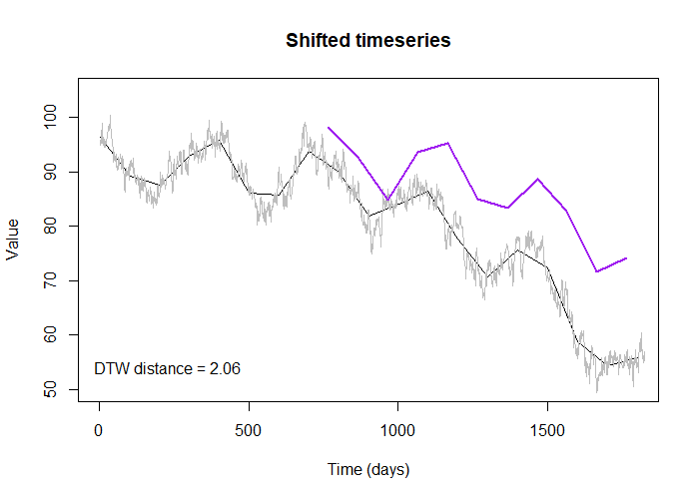
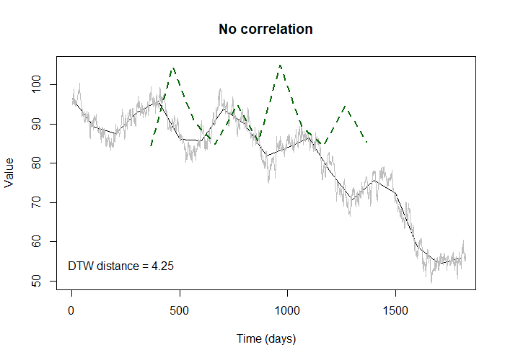
The Prototype -
Matching Simulated Time-Series
This ‘distance’ is much higher for uncorrelated time-series
Dynamic time warping (DTW) allows for shifts (or lags) when comparing time-series

Slide 11
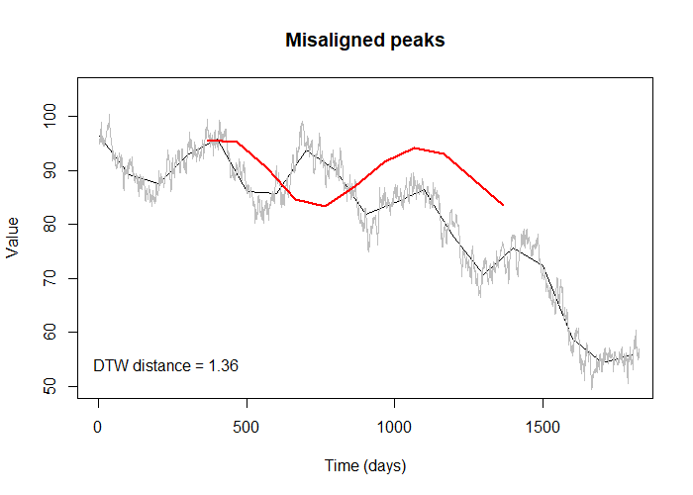

The Prototype -
Matching Simulated Time-Series
DTW distance can also capture ‘stretches’ of timeseries

Slide 12
The Future of the Data Synapse Developments
Initial prototype focuses on comparing climate and economic data
SPECIFIC GOALS:
An accessible database of climate, economic (and health) datasets, for identification of links between underexplored factors.
Enable exploratory analyses to identify potentially relevant correlations.
Aid comparisons with missing data or short time series by supplementing from other sources.
Connect researchers, support open research and sharing of data and credit between different research groups.

Slide 13
The Future of the Data Synapse Developments
Initial prototype focuses on comparing climate and economic data
Future developments:
Collating a database (via user upload) of datasets in each category, for wide-range search and connection functionality
Strong documentation requirements and crediting of original researchers/data collectors for further work using insights generated
Additional categories for upload and comparison, including health datasets - longer term vision could include projects in different disciplines
Improved functionality for data analysis and processing methods
Consultation with a range of disabled researchers, researchers from historically excluded regions and communities and the public to improve accessibility of features and documentation

Slide 14
The Ideathon Challenge and The Data Synapse
How would your platform allow users to demonstrate that any metrics/models developed on the platform are useful in the real-world?
Guidance against inappropriate assumptions - provision of a guide for users to fit appropriate processing and analysis techniques for their data type
Our tool provides only speculative correlations and relationships - users are given a selection of possible datasets and use their own subject expertise and hypothesis-driven science to work out what is and is not relevant and how to move forward
An evaluation report-back system for researchers to provide feedback on whether useful collaborations or projects arose from insights on the platform

Slide 15
The Ideathon Challenge and The Data Synapse
2. How will you ensure your results generalise to continually updated climate and economic data as well as new data sources?
Developing a repository and search tool where data uploaded for analysis are also added to a larger database for users to search for links

Slide 16
The Ideathon Challenge and The Data Synapse
3. How will your platform, in particular analysis and visualisation tools, handle uncertainty and variability in climate data?
Tool deals with small-scale variability, like daily fluctuations, and finds the meaningful variability across longer time scales
Building larger database to amalgamate multiple datasets to reduce heterogeneity of individual datasets
Researchers are given speculative links and correlations, and will account for the variability they know is present in their own field of expertise

Slide 17
Contributions of the Team
Ciara:
Scoping the problem and brainstorming; selecting solutions and identifying limitations; developing the future of the tool; graphic design; identifying EDI and research culture considerations; refining and editing the pitch.
Great v i b e s.
Ethan:
Suggesting appropriate correlation metrics based on problem scope; writing the prototype code; testing data simulation methods.
Great v i b e s.
Kristina:
Scoping the problem and brainstorming; considering the application of the developed tool; fine-tuning the overall objectives; developing the future of the tool; building the narrative for the pitch presentation; identifying limitations in proposed solutions; refining the pitch.
Great v i b e s. Snacks.

